Slide 1
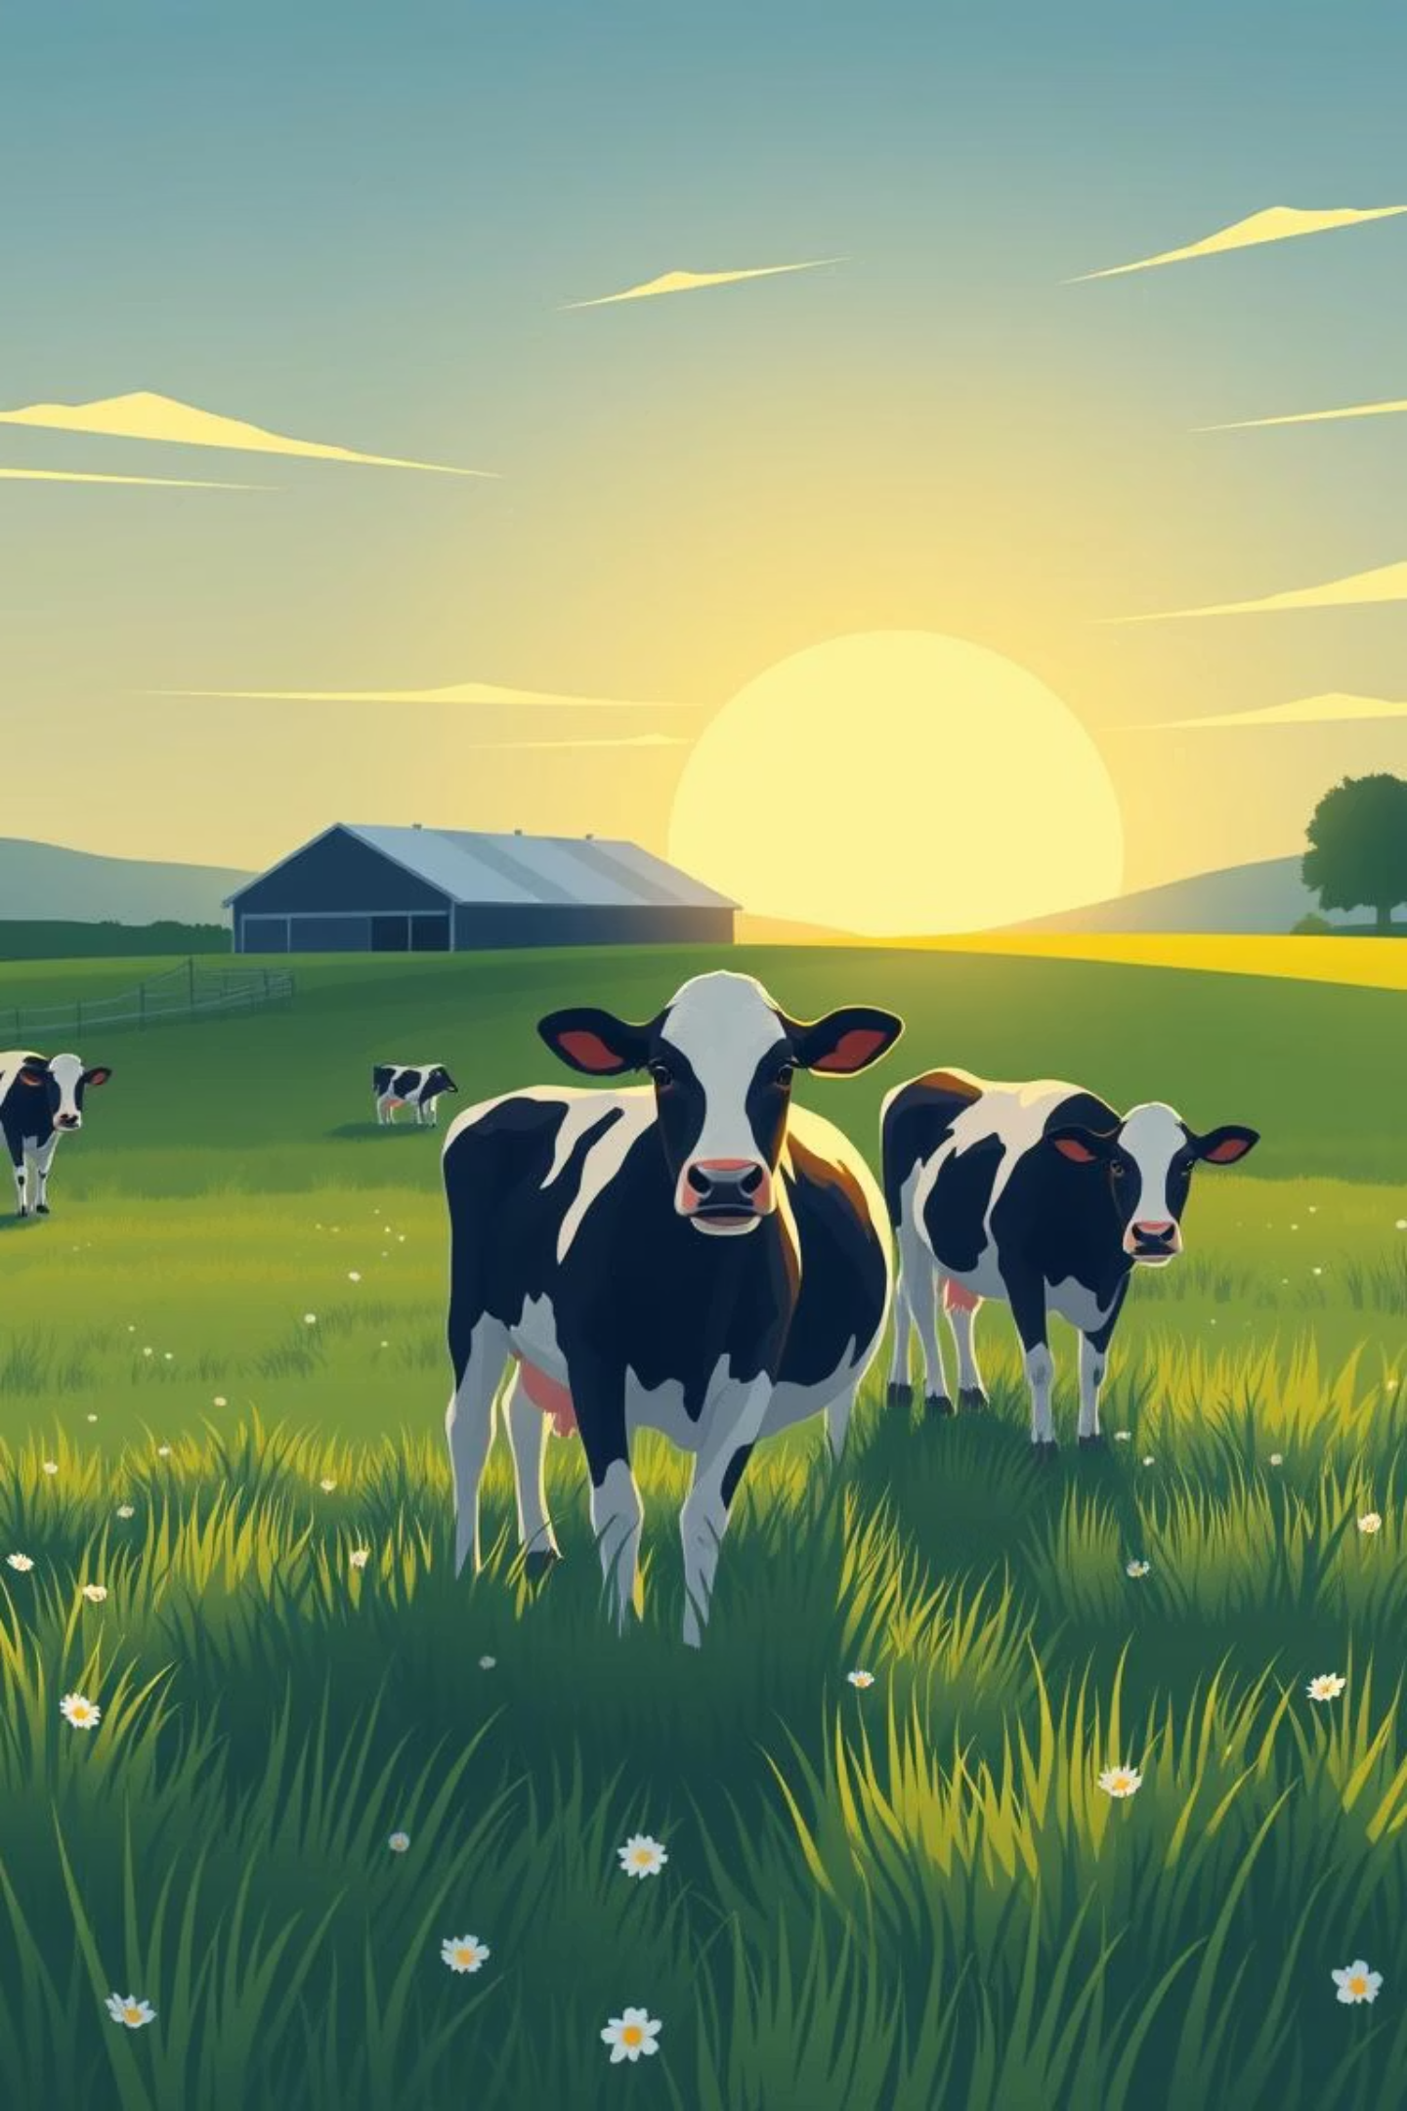
AI/ML-Based Cattle Monitoring Platform
Milk Yield Forecasting & Disease Detection
Presented by: Code Blooded

Slide 2



Optimizing Dairy Farming for a Sustainable Future
Dairy farming is a cornerstone of global agriculture, providing essential nutrition and economic stability. Milk, a vital product, faces increasing demand. However, the industry grapples with significant challenges:
Fluctuating Milk Yield
Delayed Disease Detection
The Need for Innovation
Variability in milk production can impact profitability and supply chain reliability.
To address these issues, a modern AI/ML-based solution is crucial for enhancing efficiency and animal welfare.
Current methods often lead to late identification of illnesses, resulting in decreased yield and increased treatment costs.

Slide 3


The Cost of Unseen Problems
Dairy farmers constantly monitor their herds, but the subtle signs of distress or illness are often missed until it's too late.
Complex Yield Factors
Sudden Drops, Serious Concerns
Milk yield is a delicate balance influenced by nutrition, activity levels, environmental conditions, and overall health.
An unexpected decrease in milk production is a critical indicator of underlying stress or serious illnesses like mastitis or Foot-and-Mouth Disease (FMD).
The High Price of Manual Checks
Our Clear Objective
Reliance on manual observation leads to delayed detection, significant economic losses, and compromised animal welfare.
We aim to provide early prediction capabilities for milk yield and disease onset, enabling proactive interventions and preventing costly losses.

Slide 4




Our AI/ML-Powered Solution
We propose a comprehensive platform designed to revolutionize cattle monitoring through predictive analytics and intelligent recommendations.
Intelligent Platform
Predictive Yield
An advanced AI/ML system at its core for data analysis.
Accurately forecasts daily milk output for each individual cow.
Early Disease Detection
Actionable Insights
Identifies the earliest indicators of potential health issues.
Provides preventive and corrective recommendations via an intuitive dashboard.

Slide 5
The Data Driving Our Intelligence
Our platform thrives on rich, multi-dimensional data inputs, creating a holistic view of each animal's well-being and productivity.
Animal-Specific Data
Behavioral Metrics
Breed, age, weight
Walking distance and patterns
Lactation stage, parity (number of calvings)
Grazing duration
Individual health history
Rumination cycles, rest hours
Nutritional Inputs
Physiological & Environmental Factors
Type of feed provided
Body temperature, heart rate
Quantity and frequency of feeding
Veterinary visit records
Ambient temperature, humidity, season
Housing conditions

Slide 6
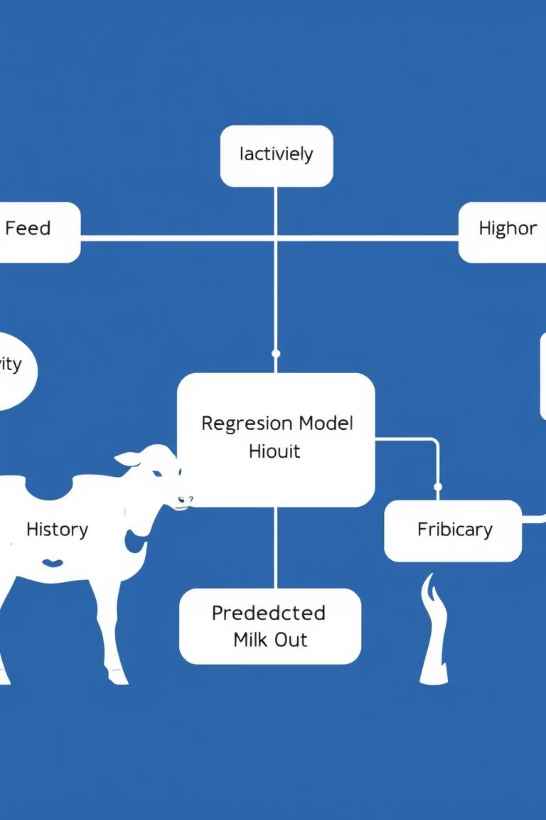
Model 1: Precision Milk Yield Forecasting
Our first core model focuses on accurately predicting individual cow milk output, empowering farmers to optimize resources and maximize production.
Regression/Forecasting
Key Inputs
Utilizes advanced algorithms to predict continuous values.
Integrates feed intake, activity levels, environmental data, and historical production records.
Strategic Impact
Facilitates better logistics planning, fine-tuned feed optimization, and overall yield increase.

Slide 7

Model 2: Proactive Disease Detection
Our second critical model acts as an early warning system, identifying potential health issues before they escalate, safeguarding animal welfare and productivity.
Classification Model
Key Indicators
Targeted Alerts
Categorizes data to identify the presence or absence of specific diseases.
Analyzes subtle changes in health parameters, activity patterns, and deviations from historical norms.
Generates timely alerts for common dairy ailments such as mastitis, digestive disorders, and mineral deficiencies.

Slide 8
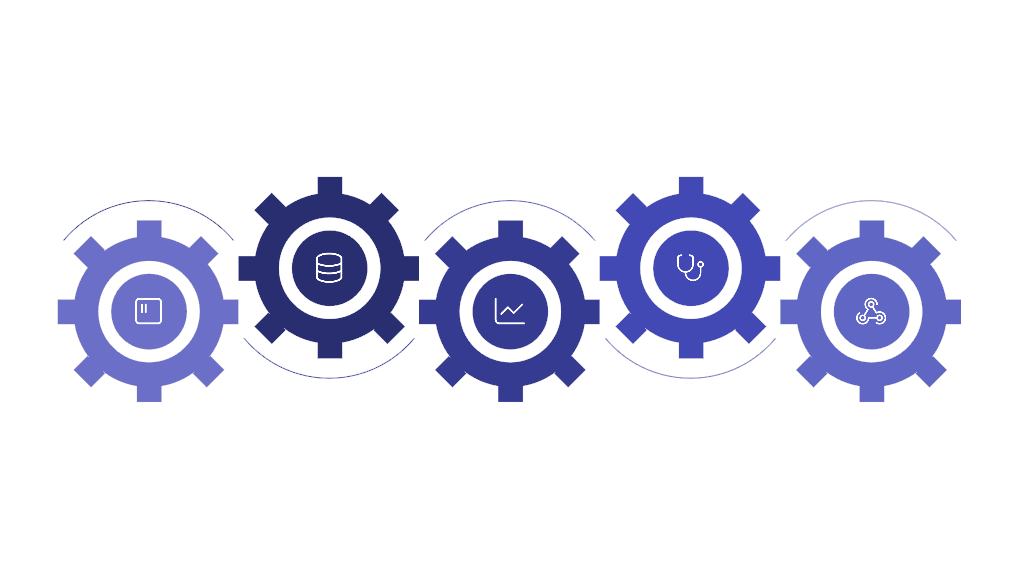





System Architecture: Seamless Integration
Our platform is built on a robust and scalable architecture, ensuring smooth data flow from collection to actionable insights.
Preprocessing
Disease Detection
Cleaning and normalization
ML model for health anomaly alerts
Data Collection
Milk Yield Prediction
Backend API
Manual input
ML model for production forecasting
Integrates model outputs and services
Data Collection: Manual input and IoT sensors.
Preprocessing & Storage: Cleaning and secure database.
ML Models: Core intelligence for predictions.
API & Dashboard: User-friendly interface and data access.
Reporting: Customizable farm management reports.

Slide 9
Benefits & Future Vision
Our platform offers immediate advantages for dairy farmers and paves the way for significant future advancements in smart agriculture.
Immediate Benefits
Future Scope
Reduced Losses: Early disease detection minimizes impact on yield and health.
Full IoT Integration: Seamless connection with a wider range of sensors.
Optimized Resources: Efficient feed and resource planning for maximum output.
Tele-Veterinary Support: Remote consultation and diagnosis capabilities.
Increased Productivity: Enhanced milk production and farmer profitability.
Advanced Breeding Suggestions: AI-driven recommendations for breeding programs.
Cloud Deployment: Enhanced accessibility and scalability for all farm sizes.

